Slide 1
Fire Hazard Analysis in Bejaia and Sidi-Bel Abbes Regions
IDA MiniProject
By Rhea Tiwari

Slide 2
Introduction
The comprehensive dataset provides detailed meteorological and environmental data collected over several months in the Bejaia and Sidi-Bel Abbes regions. The data collected includes essential variables such as temperature, relative humidity, wind speed, rainfall, and various fire danger indices like-
FFMC: Fine Fuel Moisture Code measures dryness of surface fuels.
DMC: Duff Moisture Code gauges moisture in decomposed organic material.
DC: Drought Code indicates long-term dryness in deep organic layers.
ISI: Initial Spread Index quantifies fire's potential initial spread rate.
BUI: Buildup Index assesses fuel available for combustion buildup.
FWI: Fire Weather Index integrates FFMC, DMC, DC, and ISI.
The dataset covers the period from June to September in 2012, allowing for a seasonal analysis of fire hazards
Understanding the factors influencing the occurrence of fire incidents is crucial for effective fire management and prevention.
The objective of analysing this dataset is to make a predictive model that can predict whether a fire will occur or not based on the various meteorological and environmental factors so that this dataset can be leveraged to assess and mitigate the risk of wildfires in these regions, aiding in proactive fire management and prevention strategies.

Slide 3
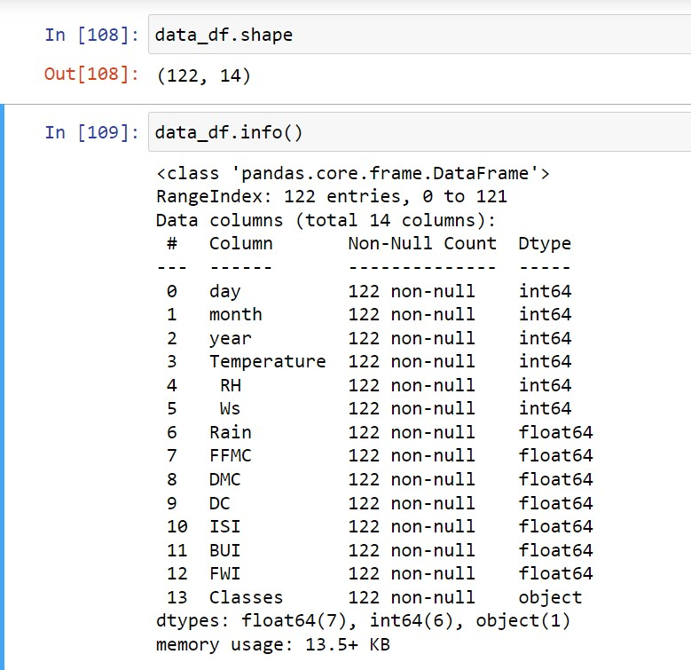
Methodology
Data Preparation and Exploration:
The first step was opening the dataset and then dividing it into two different files as there were two different datasets in one file and then converting them to csv files.The next step was cleaning the data involved by removing any null and/or unwanted and redundant values from the dataset. Ensuring all data is appropriate for analysis.
The next step involved finding out the basic details of the chosen datset like the shape to figure out the numbers of columns and rows in it and then using the info() functions to find out the column names and the dtype of these values in these columns.
Then we use the describe function to generate descriptive statistics of the dataframe . It provides information such as count, mean, standard deviation, minimum, and maximum values.

Slide 4
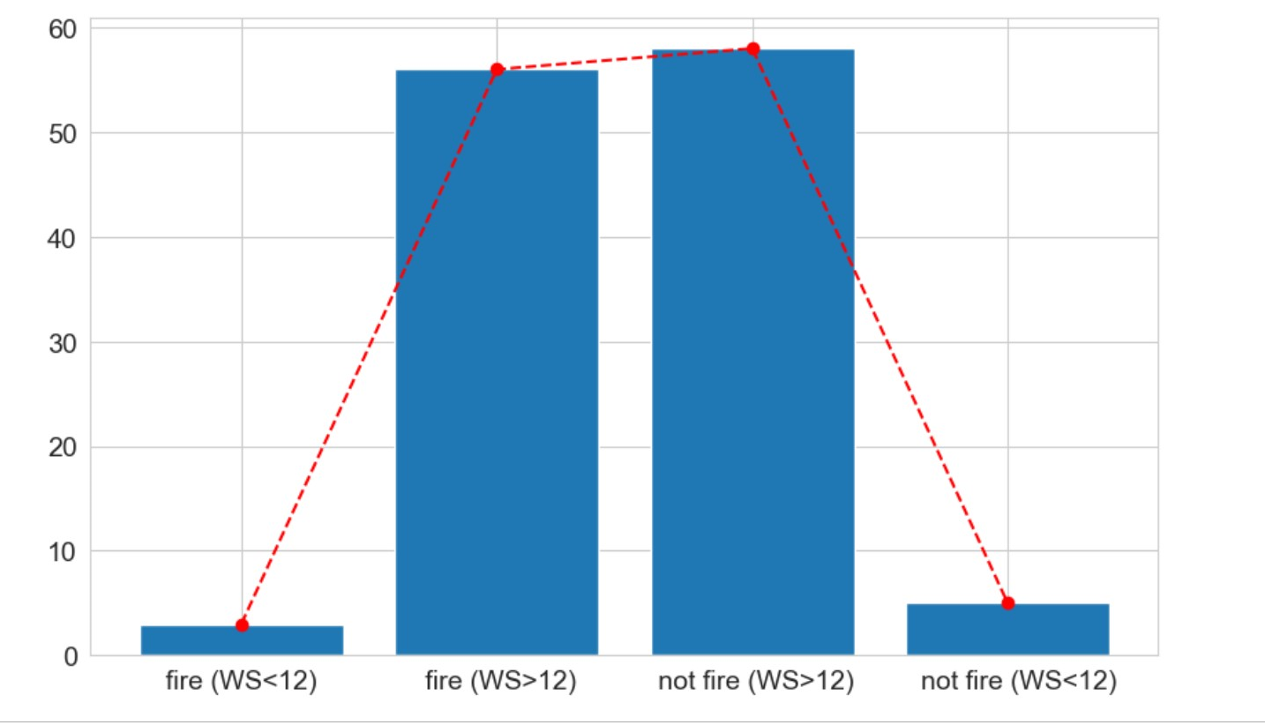
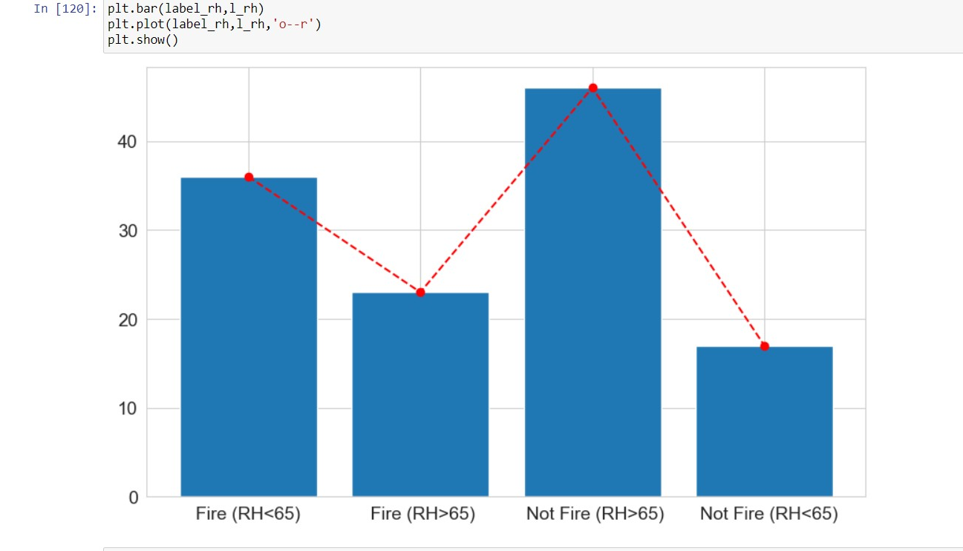
Illustrations of Graphs
The first step was importing matplotlib and setting the plotting style and font size.Then the next step was to show the covariance and correlation of the various parameters with the feature Classes which contains the information of whether a fire occurred or not.
We used various functions to identify which meteorological and environmental factors have more or less of an effect on whether forest fires will occur or not.
Then using lists to count and divide subsets of Classes- Fire and Not Fire-according to different categories depending on the parameters used.Then using these lists I made bar graphs and plotted line graphs to emphasise and visualise the differences and correlations between these enivornmental factors and forest fires used

Slide 5
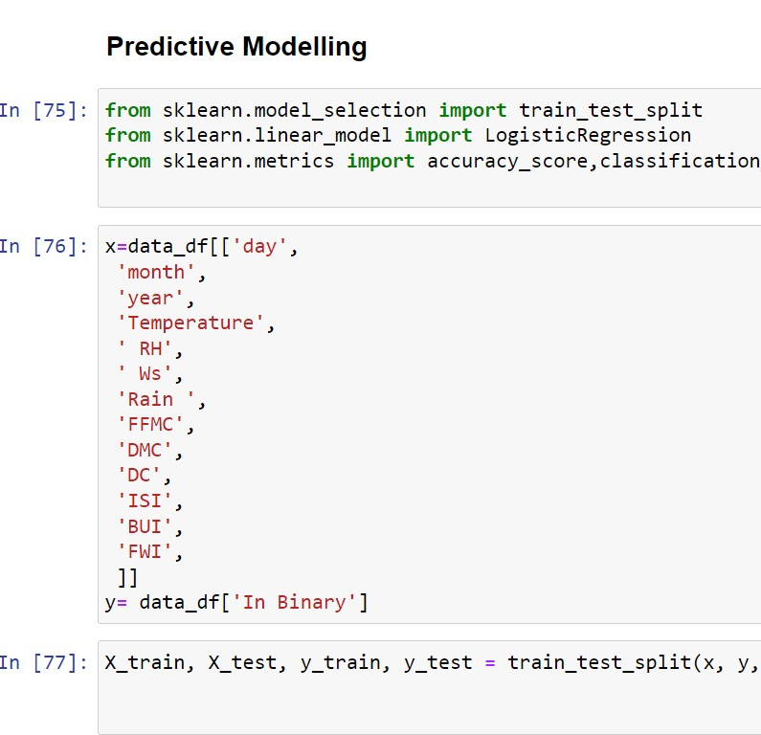
Data Modeling and Model Validation
I developed a predictive model employing machine learning, specifically logistic regression, chosen for its suitability to the dataset's characteristics. To enhance model performance, I applied feature scaling during training. The trained model demonstrated accurate predictions during testing, ensuring its reliability.

Slide 6
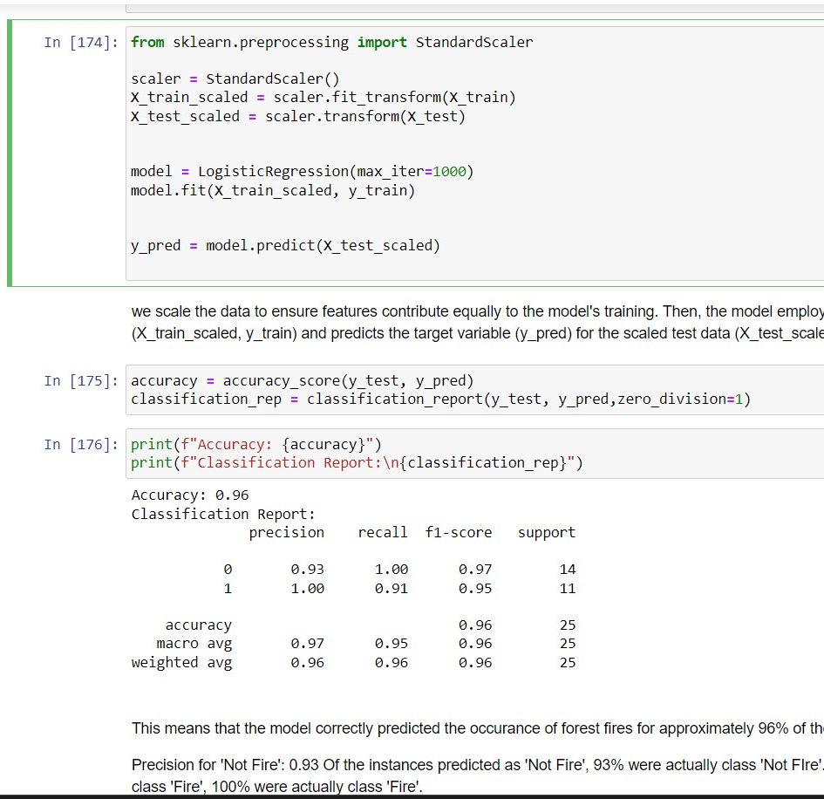
Based on the analysis, we can see that the model predicts the occurrence of a forest fire correctly 96% of the time.
Analysing the relationship between the various parameters using various bar graphs and functions like covariance and correlation suggests that some parameters are more important than others when predicting the occurrence of forest fires.

Slide 7
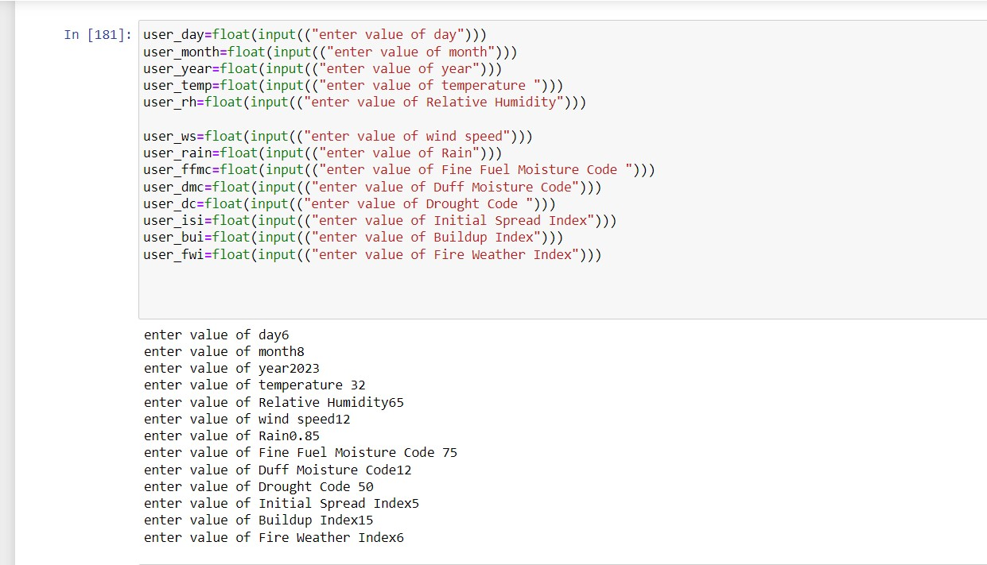
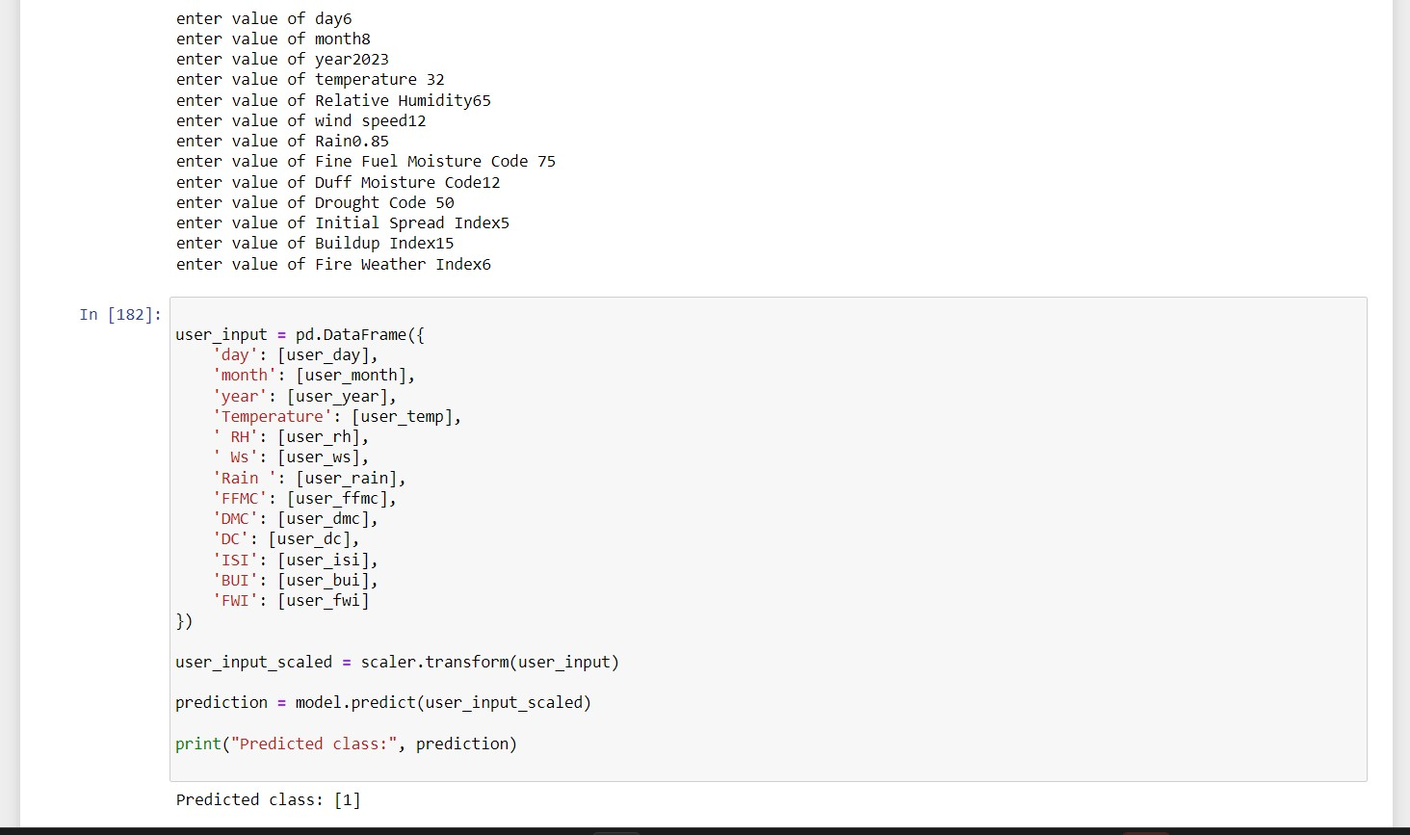
Subsequently, I designed a user-friendly interface allowing individuals to input their collected meteorological and environmental data, enabling users to receive predictions regarding the likelihood of a forest fire occurrence based on their entered data. The model's scalability and adaptability make it a valuable tool for people seeking efficient and data-driven solutions in forest fire prevention and management

Slide 8


